Slide 1
Announcements
Assignments:
HW5
Due Tue 2/26, 10 pm
HW6 and P3
Coming soon
Travel
Pat out Wed 2/27, back for Mon 3/4
SIGCSE 2019, Minneapolis

Slide 2

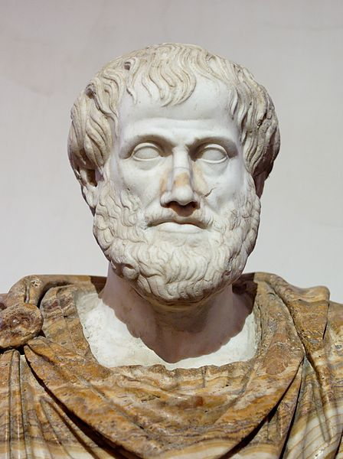
AI: Representation and Problem Solving
First-Order Logic
Instructors: Pat Virtue & Stephanie Rosenthal
Slide credits: CMU AI, http://aima.eecs.berkeley.edu

Slide 3
Outline
Need for first-order logic
Syntax and semantics
Planning with FOL
Inference with FOL

Slide 4

Pros and Cons of Propositional Logic
Propositional logic is declarative: pieces of syntax correspond to facts
Propositional logic allows partial/disjunctive/negated information (unlike most data structures and databases)
Propositional logic is compositional: meaning of B_{1,1} ∧ P_{1,2} is derived from meaning of B_{1,1} and of P_{1,2}
Meaning in propositional logic is context-independent (unlike natural language, where meaning depends on context)
Propositional logic has very limited expressive power (unlike natural language)
E.g., cannot say “pits cause breezes in adjacent squares” except by writing one sentence for each square

Slide 5
Pros and Cons of Propositional Logic
Rules of chess:
100,000 pages in propositional logic
1 page in first-order logic
Rules of pacman:
∀x,y,t At(x,y,t) ⇔ [At(x,y,t-1) ∧ ¬∃ u,v Reachable(x,y,u,v,Action(t-1))] v
[∃ u,v At(u,v,t-1) ∧ Reachable(x,y,u,v,Action(t-1))]

Slide 6

First-Order Logic (First-Order Predicate Calculus)
Whereas propositional logic assumes world contains facts,
first-order logic (like natural language) assumes the world contains
Objects: people, houses, numbers, theories, Ronald McDonald, colors, baseball games, wars, centuries, ...
Relations: red, round, bogus, prime, multistoried ...,
brother of, bigger than, inside, part of, has color, occurred after, owns, …
Functions: father of, best friend, third inning of, one more than, end of, …

Slide 7

Logics in General
Language | What exists in the world | What an agent believes about facts
Propositional logic | Facts | true / false / unknown
First-order logic | facts, objects, relations | true / false / unknown
Probability theory | facts | degree of belief
Fuzzy logic | facts + degree of truth | known interval value

Slide 8

Syntax of FOL
Basic Elements
Constants Predicates Functions Variables Connectives Equality Quantifiers
KingJ ohn, 2, CMU, . . .
Brother, >, . . .
Sqrt, LeftLegOf, . . .
x, y, a, b, . . .
∧ ∨ ¬ ⇒ ⇔
=
∀ ∃

Slide 9
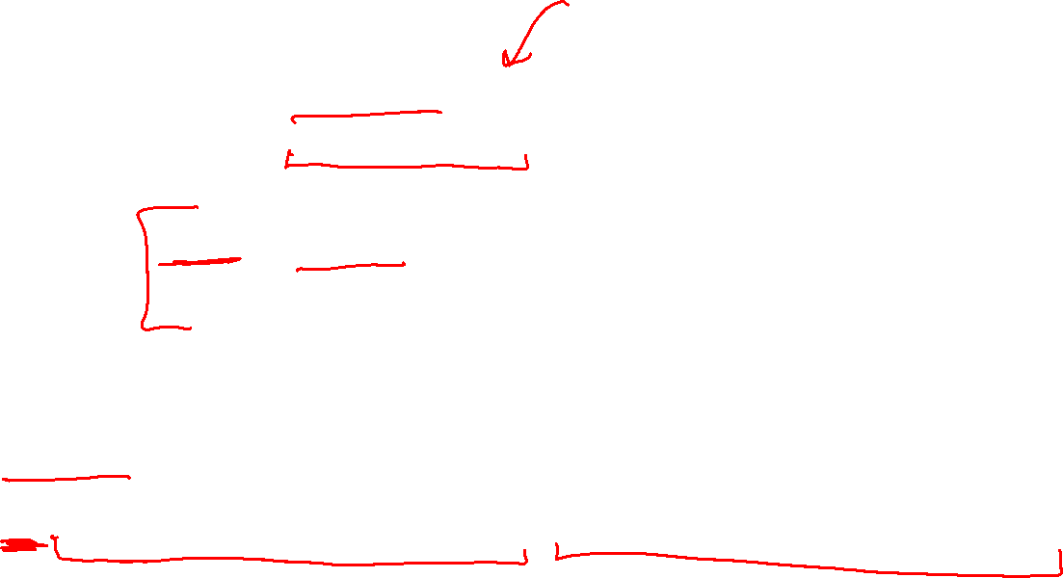
Syntax of FOL
Atomic sentence = predicate(term₁, . . . , term_{n})
or term₁ = term₂
Term = function(term₁, . . . , term_{n})
or constant
or variable
Examples
Brother(KingJ ohn, RichardT heLionheart)
> (Length(LeftLegOf (Richard)), Length(LeftLegOf (KingJ ohn)))

Slide 10
Syntax of FOL
Complex sentences are made from atomic sentences using connectives
¬S, S₁ ∧ S₂, S₁ ∨ S₂, S₁ ⇒S₂, S₁ ⇔ S₂
Examples
Sibling(KingJ ohn, Richard) ⇒ Sibling(Richard, KingJ ohn)
>(1, 2) ∨ ≤(1, 2)
>(1, 2) ∧ ¬>(1, 2)

Slide 11
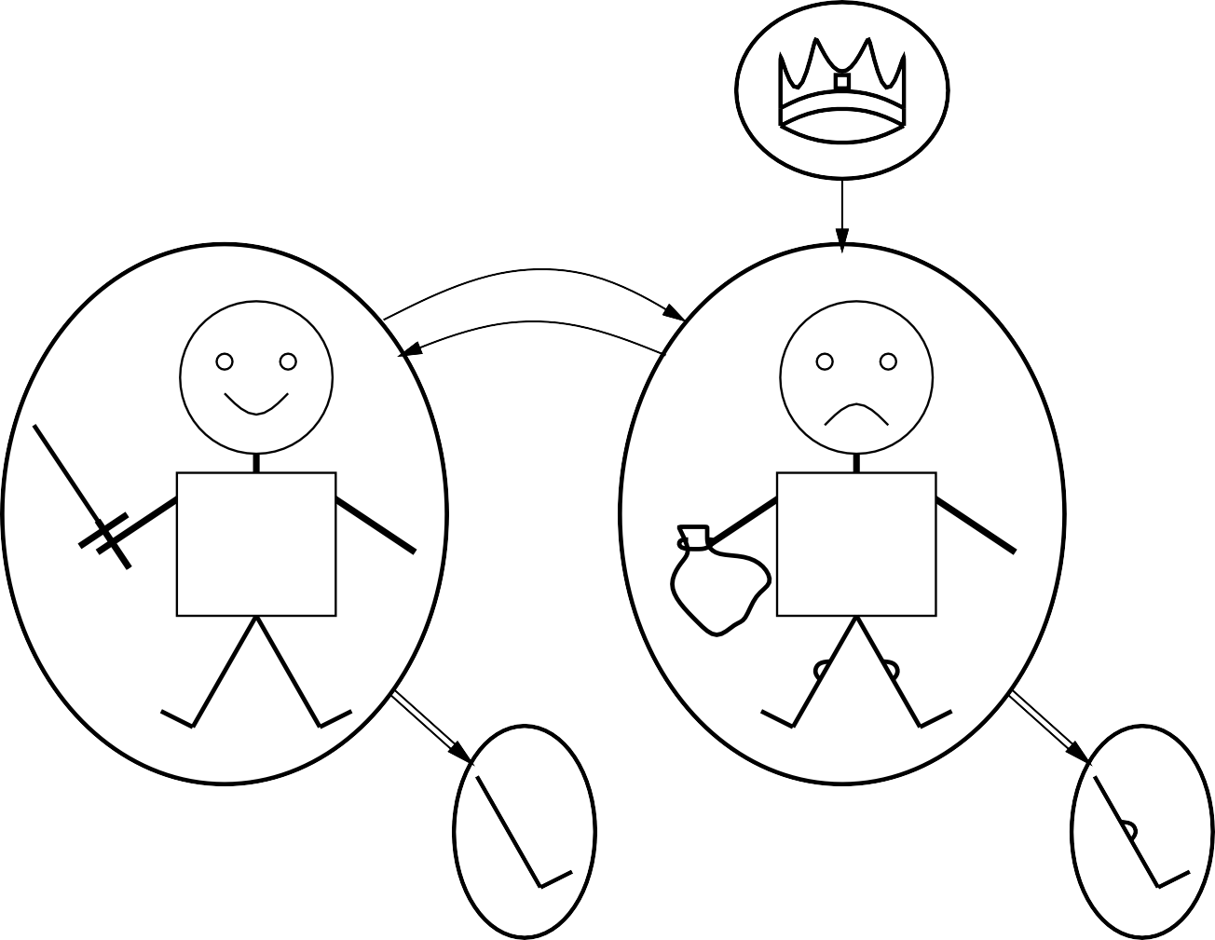
Models for FOL
Example
crown
on head
person king
person
brother
brother
R
J
$
left leg
left leg

Slide 12
Models for FOL
crown
brother
on head
person king
person
Brother(Richard, John)
Consider the interpretation in which:
Richard → Richard the Lionheart
John → the evil King John
Brother → the brotherhood relation
brother
R
J
$
left leg
left leg

Slide 13
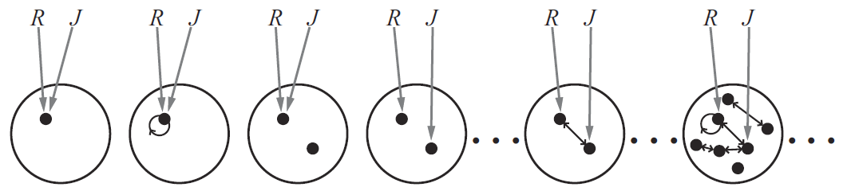
Model for FOL
crown
brother
on head
person king
person
Lots of models!
brother
R
J
$
left leg
left leg

Slide 14

Model for FOL
Lots of models!
Entailment in propositional logic can be computed by enumerating models
We can enumerate the FOL models for a given KB vocabulary: For each number of domain elements n from 1 to ∞
For each k-ary predicate P_{k} in the vocabulary
For each possible k-ary relation on n objects
For each constant symbol C in the vocabulary
For each choice of referent for C from n objects . . .
Computing entailment by enumerating FOL models is not easy!

Slide 15
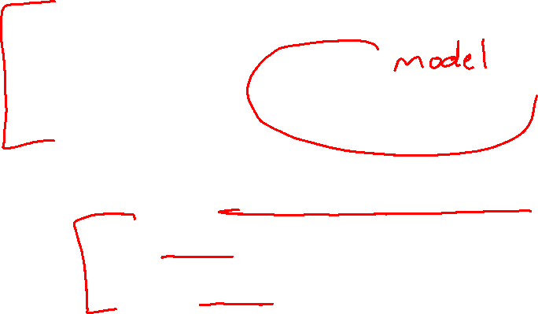
Truth in First-Order Logic
Sentences are true with respect to a model and an interpretation
Model contains ≥ 1 objects (domain elements) and relations among them Interpretation specifies referents for
constant symbols → objects
predicate symbols → relations
function symbols → functional relations
An atomic sentence predicate(term₁, . . . , term_{n}) is true:
iff the objects referred to by term₁, . . . , term_{n}
are in the relation referred to by predicate

Slide 16

Models for FOL
crown
brother
on head
person king
person
Consider the interpretation in which:
Richard → Richard the Lionheart John → the evil King John
Brother → the brotherhood relation
Under this interpretation, Brother(Richard, John) is true just in the case Richard the Lionheart and the evil King John are in the brotherhood relation in the model
brother
R
J
$
left leg
left leg

Slide 17

Universal Quantification
∀ (variables) (sentence)
Everyone at the banquet is hungry:
∀ x At(x, Banquet) ⇒ Hungry(x)
∀ x P is true in a model m iff P is true with x being
each possible object in the model
Roughly speaking, equivalent to the conjunction of instantiations of P
(At(KingJ ohn, Banquet) ⇒ Hungry(KingJ ohn))
∧ (At(Richard, Banquet) ⇒ Hungry(Richard))
∧ (At(Banquet, Banquet) ⇒ Hungry(Banquet))
∧ . . .

Slide 18
Universal Quantification
Common mistake
Typically, ⇒ is the main connective with ∀
Common mistake: using ∧ as the main connective with ∀:
∀ x At(x, Banquet) ∧ Hungry(x)
means “Everyone is at the banquet and everyone is hungry”

Slide 19

Existential Quantification
∃ (variables) (sentence)
Someone at the tournament is hungry:
∃ x At(x, Tournament) ∧ Hungry(x)
∃ x P is true in a model m iff P is true with x being
some possible object in the model
Roughly speaking, equivalent to the disjunction of instantiations of P
(At(KingJ ohn, Tournament) ∧ Hungry(KingJ ohn))
∨ (At(Richard, Tournament) ∧ Hungry(Richard))
∨ (At(Tournament, Tournament) ∧ Hungry(Tournament))
∨ . . .

Slide 20
Existential Quantification
Common mistake
Typically, ∧ is the main connective with ∃
Common mistake: using ⇒ as the main connective with ∃:
∃ x At(x, Tournament) ⇒ Hungry(x)
is true if there is anyone who is not at the tournament!

Slide 21
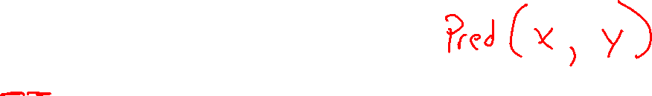
Properties of Quantifiers
∀ x | ∀ y | is the same as ∀ y | ∀ x
∃ x | ∃ y | is the same as ∃ y | ∃ x
∃ x | ∀ y | is not the same as | ∀ y | ∃ x
∃ x ∀ y Loves(x, y)
“There is a person who loves everyone in the world”
∀ y ∃ x Loves(x, y)
“Everyone in the world is loved by at least one person”
Quantifier duality: each can be expressed using the other
∀ x Likes(x, IceCream)
∃ x Likes(x, Broccoli)
¬∃ x ¬Likes(x, IceCream)
¬∀ x ¬Likes(x, Broccoli)

Slide 22
Fun with Sentences
Brothers are siblings
∀ x, y Brother(x, y) ⇒ Sibling(x, y).
“Sibling” is symmetric
∀ x, y Sibling(x, y) ⇔ Sibling(y, x).
A first cousin is a child of a parent’s sibling
∀ x, y FirstCousin(x, y) ⇔ ∃ p, ps Parent(p, x) ∧ Sibling(ps, p) ∧ Parent(ps, y)

Slide 23
Equality
term₁ = term₂ is true under a given interpretation
if and only if term₁ and term₂ refer to the same object
E.g., 1 = 2 and ∀ x × (Sqrt(x), Sqrt(x)) = x are satisfiable
2 = 2 is valid
E.g., definition of (full) Sibling in terms of Parent:
∀ x, y Sibling(x, y) ⇔
[¬(x = y) ∧ ∃ m, f ¬(m = f ) ∧
Parent(m, x) ∧ Parent(f, x) ∧ Parent(m, y) ∧ Parent(f, y)]

Slide 24
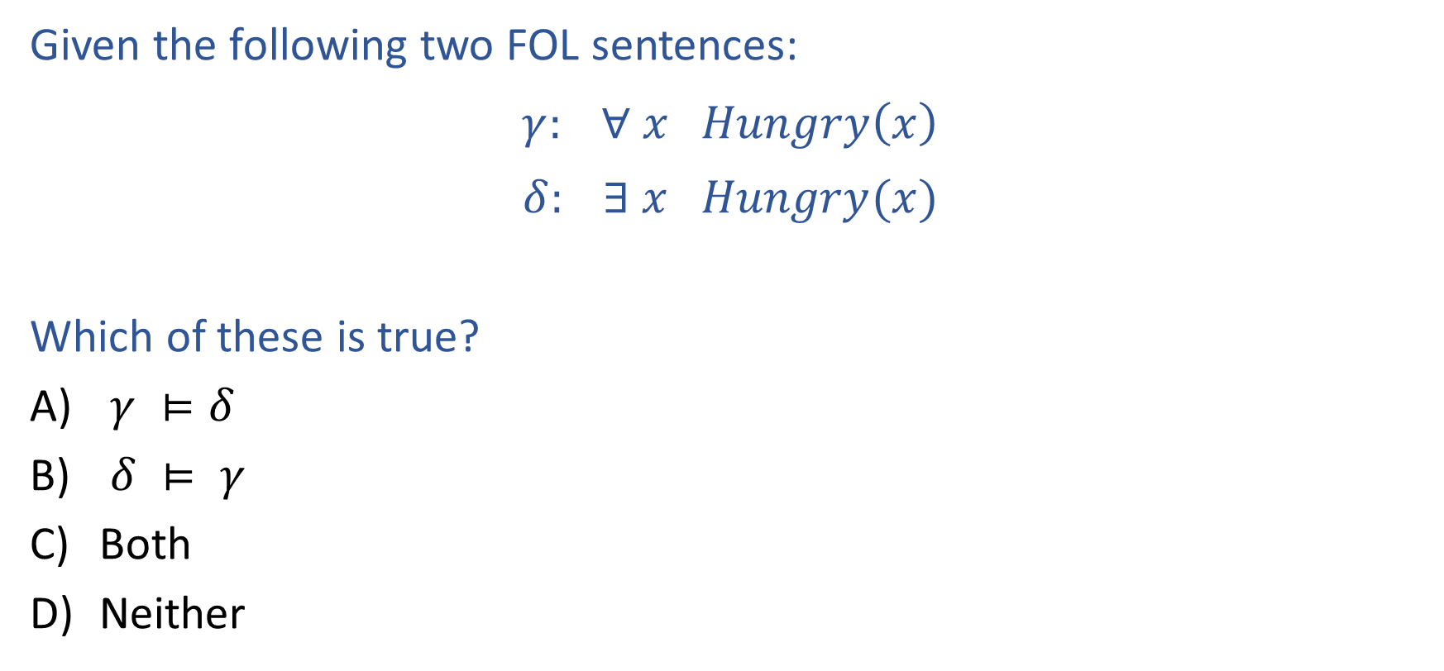
Piazza Poll 1
Given the following two FOL sentences:
$$γ: ∀ x Hungry\left(x\right)$$
$$δ: ∃ x Hungry(x)$$
Which of these is true?
$γ ⊨δ$
$δ ⊨ γ$
Both
Neither

Slide 25

Piazza Poll 1
Given the following two FOL sentences:
$$γ: ∀ x Hungry\left(x\right)$$
$$δ: ∃ x Hungry(x)$$
Which of these is true?
$γ ⊨δ$
$δ ⊨ γ$
Both
Neither

Slide 26

Interacting with FOL KBs
Suppose a wumpus-world agent is using an FOL KB
and perceives a smell and a breeze (but no glitter) at t = 5:
T ell(KB, P ercept([Smell, Breeze, N one], 5))
Ask(KB, ∃ a Action(a, 5))
i.e., does KB entail any particular actions at t = 5?
Answer: Y es
Given a sentence S and a substitution σ,
Sσ denotes the result of plugging σ into S; e.g.,
S = Smarter(x, y)
σ = {x/EVE, y/WALL-E}
Sσ = Smarter(EVE, WALL-E)
Ask(KB, S) returns some/all σ such that KB |= Sσ
, {a/Shoot} ← substitution (binding list)
Notation Alert!
Notation Alert!

Slide 27

Knowledge Base for Wumpus World
“Perception”
∀ b, g, t P ercept([Smell, b, g], t) ⇒ Smelt(t)
∀ s, b, t P ercept([s, b, Glitter], t) ⇒ AtGold(t)
Reflex: ∀ t AtGold(t) ⇒ Action(Grab, t)
Reflex with internal state: do we have the gold already?
∀ t AtGold(t) ∧ ¬Holding(Gold, t) ⇒ Action(Grab, t)
Holding(Gold, t) cannot be observed
⇒ keeping track of change is essential

Slide 28

Deducing Hidden Properties
Properties of locations:
∀ x, t At(Agent, x, t) ∧ Smelt(t) ⇒ Smelly(x)
∀ x, t At(Agent, x, t) ∧ Breeze(t) ⇒ Breezy(x)
Squares are breezy near a pit:
Diagnostic rule—infer cause from effect
∀ y Breezy(y) ⇒ ∃ x Pit(x) ∧ Adjacent(x, y)
Causal rule—infer effect from cause
∀ x, y Pit(x) ∧ Adjacent(x, y) ⇒ Breezy(y)
Neither of these is complete — e.g., the causal rule doesn’t say whether squares far away from pits can be breezy
Definition for the Breezy predicate:
∀ y Breezy(y) ⇔ [∃ x Pit(x) ∧ Adjacent(x, y)]

Slide 29
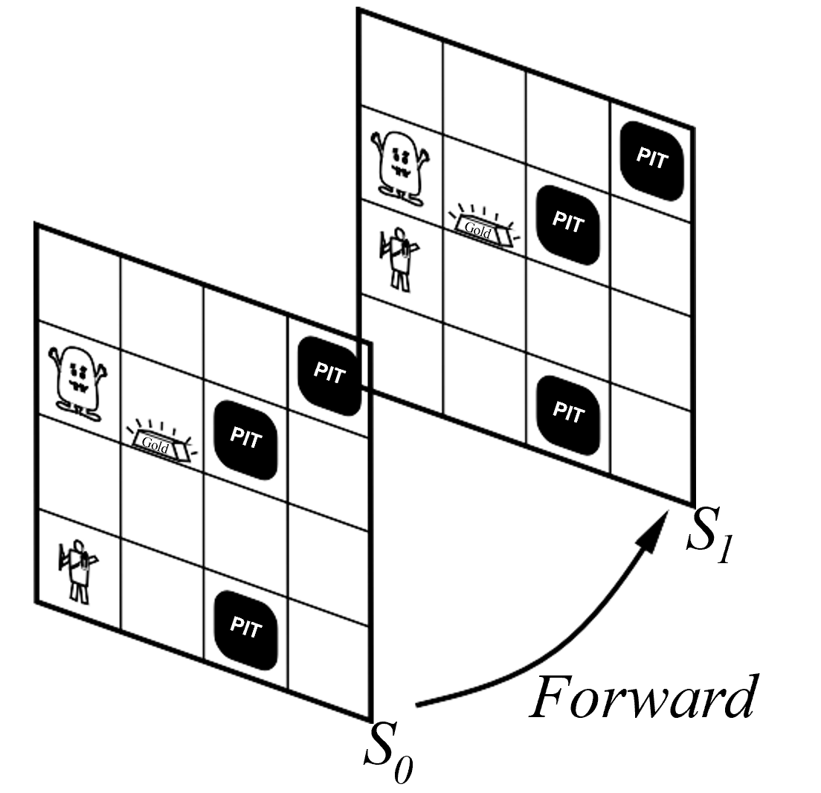
Keeping Track of Change
Facts hold in situations, rather than eternally
E.g., Holding(Gold, Now) rather than just Holding(Gold)
Situation calculus is one way to represent change in FOL:
Adds a situation argument to each non-eternal predicate E.g., Now in Holding(Gold, Now) denotes a situation
Situations are connected by the Result function
Result(a, s) is the situation that results from doing a in s

Slide 30

Describing Actions
“Effect” axiom—describe changes due to action
∀ s AtGold(s) ⇒ Holding(Gold, Result(Grab, s))
“Frame” axiom—describe non-changes due to action
∀ s HaveArrow(s) ⇒ HaveArrow(Result(Grab, s))
Successor-state axioms solve the representational frame problem
Each axiom is “about” a predicate (not an action per se):
P true afterwards
⇔ [an action made P true
∨ P true already and no action made P false]
For holding the gold:
∀ a, s Holding(Gold, Result(a, s)) ⇔
[(a = Grab ∧ AtGold(s))
∨ (Holding(Gold, s) ∧ ¬(a = Release) )]

Slide 31

Describing Actions
Initial condition in KB:
At(Agent, [1, 1], S₀)
At(Gold, [1, 2], S₀)
Query: Ask(KB, ∃ s Holding(Gold, s))
i.e., in what situation will I be holding the gold?
Answer: {s/Result(Grab, Result(Forward, S₀))}
i.e., go forward and then grab the gold
This assumes that the agent is interested in plans starting at S₀ and that S₀
is the only situation described in the KB

Slide 32

Making Plans
Represent plans as action sequences [a₁, a₂, . . . , a_{n}]
PlanResult(p, s) is the result of executing p in s
Then the query Ask(KB, ∃ p Holding(Gold, PlanResult(p, S₀)))
has the solution {p/[Forward, Grab]}
Definition of PlanResult in terms of Result:
∀ s PlanResult([ ], s) = s
∀ a, p, s PlanResult([a, p], s) = PlanResult(p, Result(a, s))

Slide 33
Outline
Need for first-order logic
Syntax and semantics
Planning with FOL
Inference with FOL

Slide 34
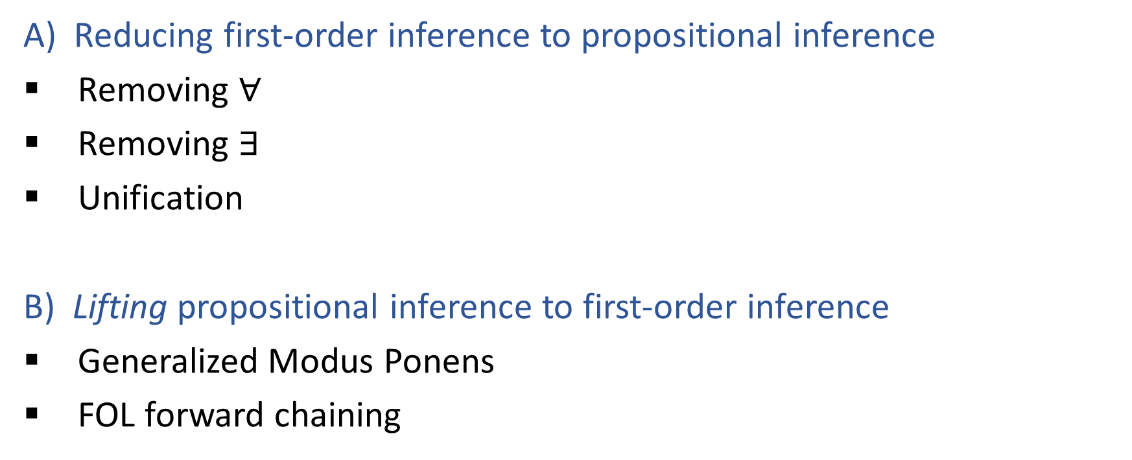
Inference in First-Order Logic
A) Reducing first-order inference to propositional inference
Removing $∀$
Removing $∃$
Unification
B) Lifting propositional inference to first-order inference
Generalized Modus Ponens
FOL forward chaining

Slide 35

Universal Instantiation
Every instantiation of a universally quantified sentence is entailed by it:
∀ v α
Subst({v/g}, α)
for any variable v and ground term g
E.g., ∀ x King(x) ∧ Greedy(x) ⇒ Evil(x) yields
King(John) ∧ Greedy(John) ⇒ Evil(John) King(Richard) ∧ Greedy(Richard) ⇒ Evil(Richard)
King(Father(John)) ∧ Greedy(Father(John))⇒ Evil(Father(John))

Slide 36

Existential Instantiation
For any sentence α, variable v, and constant symbol k
that does not appear elsewhere in the knowledge base:
∃ v α
Subst({v/k}, α)
E.g., ∃ x Crown(x) ∧ OnHead(x, J ohn) yields
Crown(C₁) ∧ OnHead(C₁, J ohn)
provided C₁ is a new constant symbol, called a Skolem constant

Slide 37
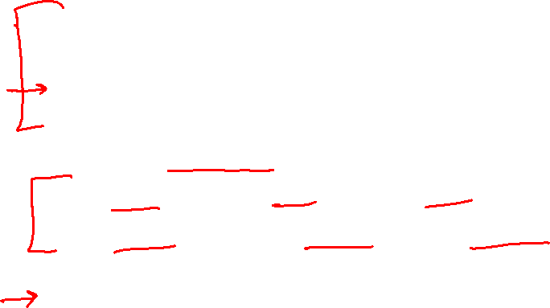
Reduction to Propositional Inference
Suppose the KB contains just the following:
∀ x King(x) ∧ Greedy(x) ⇒ Evil(x)
King(John)
Greedy(J ohn)
Brother(Richard, John)
Instantiating the universal sentence in all possible ways, we have
King(J ohn) ∧ Greedy(J ohn) ⇒ Evil(John)
King(Richard) ∧ Greedy(Richard) ⇒ Evil(Richard)
King(John)
Greedy(J ohn)
Brother(Richard, J ohn)
The new KB is propositionalized: proposition symbols are
King(J ohn), Greedy(J ohn), Evil(J ohn), King(Richard) etc.

Slide 38

Reduction to Propositional Inference
Claim: a ground sentence∗ is entailed by new KB iff entailed by original KB
Claim: every FOL KB can be propositionalized so as to preserve entailment
Idea: propositionalize KB and query, apply resolution, return result Problem: with function symbols, there are infinitely many ground terms,
e.g., Father(Father(Father(J ohn)))
Theorem: Herbrand (1930). If a sentence α is entailed by an FOL KB,it is entailed by a finite subset of the propositional KB
Idea: For n = 0 to ∞ do
create a propositional KB by instantiating with depth-n terms see if α is entailed by this KB
Problem: works if α is entailed, loops if α is not entailed
Theorem: Turing (1936), Church (1936), entailment in FOL is semidecidable

Slide 39

Problems with Propositionalization
Propositionalization seems to generate lots of irrelevant sentences. E.g., from
∀ x King(x) ∧ Greedy(x) ⇒Evil(x)
King(John)
∀ y Greedy(y)
Brother(Richard, John)
it seems obvious that Evil(John), but propositionalization produces lots of facts such as Greedy(Richard) that are irrelevant

Slide 40


Unification
We can get the inference immediately if we can find a substitution θ
such that King(x) and Greedy(x) match King(John) and Greedy(y)
θ = {x/John, y/J ohn} works
Unify(α, β) = θ if αθ = βθ
p | q | θ
Knows(J ohn, x) | Knows(J ohn, Jane) | {x/Jane}
Knows(J ohn, x) | Knows(y, OJ ) | {x/OJ, y/J ohn}
Knows(J ohn, x) | Knows(y, M other(y)) | {y/J ohn, x/M other(J ohn)}
Knows(J ohn, x) | Knows(x, OJ ) | fail
Standardizing apart eliminates overlap of variables, e.g., Knows(z₁₇, OJ )

Slide 41
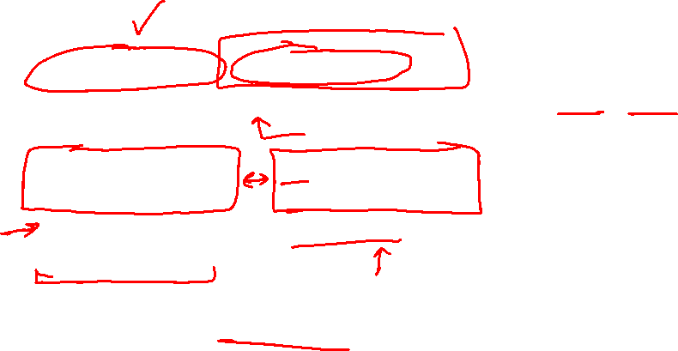
Generalized Modus Ponens (GMP)
p₁^{t},
p₂^{t}, . . . , p_{n}^{t},
(p₁ ∧ p₂ ∧ . . . ∧ p_{n} ⇒ q) qθ
t
where p_{i} θ = p_{i}θ for all i
p₁^{t} is King(J ohn) p₂^{t} is Greedy(y)
p₁ is King(x) p₂ is Greedy(x)
θ is {x/John, y/J ohn} q is Evil(x) qθ is Evil(J ohn)
GMP used with KB of definite clauses (exactly one positive literal) All variables assumed universally quantified

Slide 42
Soundness of GMP

Slide 43
Example Knowledge Base

Slide 44
Example Knowledge Base

Slide 45
FOL Forward Chaining
function FOL-FC-Ask(KB, α) returns a substitution or false
repeat until new is empty
new ← { }
for each sentence r in KB do
( p₁ ∧ . . . ∧ p_{n} ⇒ q ) ← Standardize-Apart(r)
for each θ such that (p₁ ∧ . . . ∧ p_{n})θ = (p^{t} ∧ . . . ∧ p^{t} )θ
1 n
for some p^{t} , . . . , p^{t} in KB
1 n
q ^{t} ← Subst(θ, q )
if q ^{t} is not a renaming of a sentence already in KB or new then do
add q ^{t} to new
φ ← Unify(q ^{t}, α)
if φ is not fail then return φ
add new to KB
return false

Slide 46
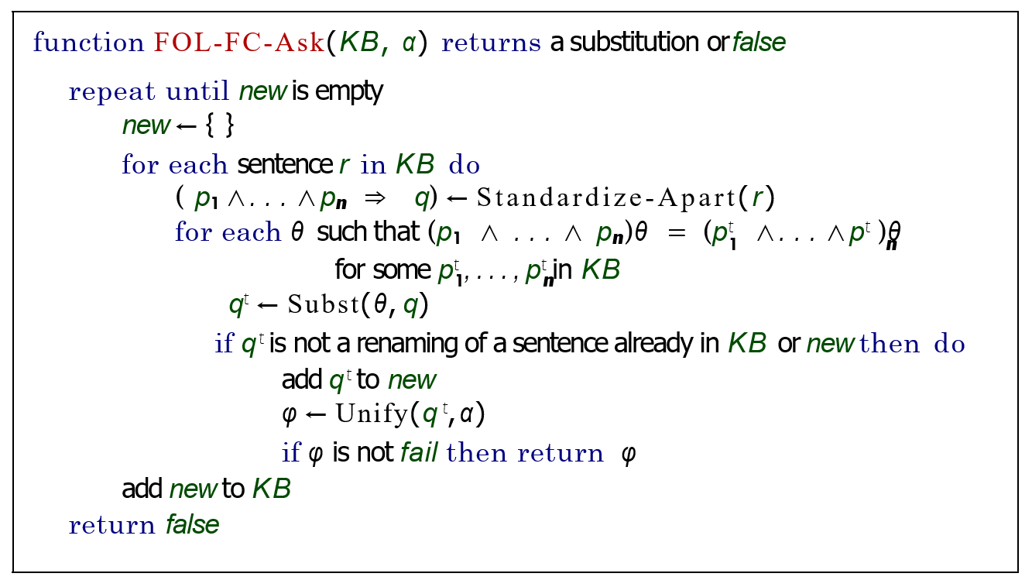

FOL Forward Chaining

Slide 47
Properties of FOL Forward Chaining

